Slide 1
Seasonality and trading days tests in JD+
ESTP training

Slide 2
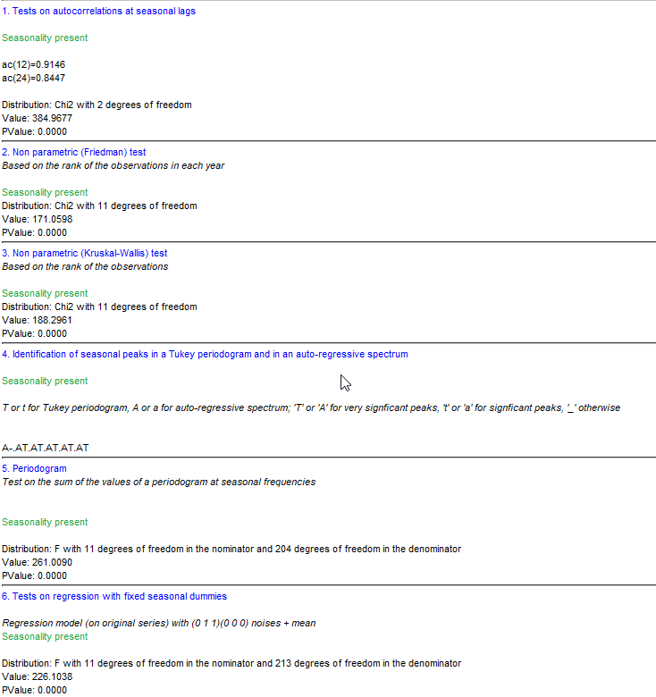
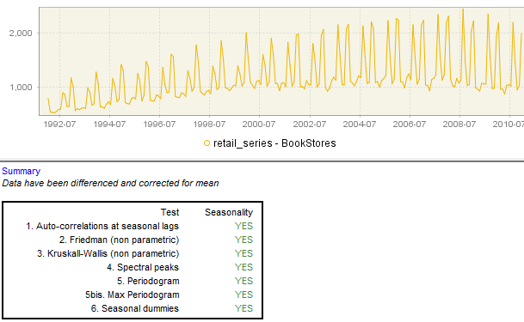
Overview

Slide 3
Seasonality tests
Non-parametric tests
Friedman
ANOVA-type. The test uses the rankings of the observations within each year. It does not require distributional assumptions.
H0: all periods can be treated equally (= no seasonality), H1: series is seasonal
P-value < 0.01 ⇒ H0 is rejected
Applied on series without trend (for instance (log) differenced series)
Kruskall-Wallis
The test uses the rankings of all the observations. It does not require distributional assumptions.
H0: All periods have the same mean(average ranking), H1: series is seasonal
Applied on series without trend (for instance (log) differenced series)

Slide 4
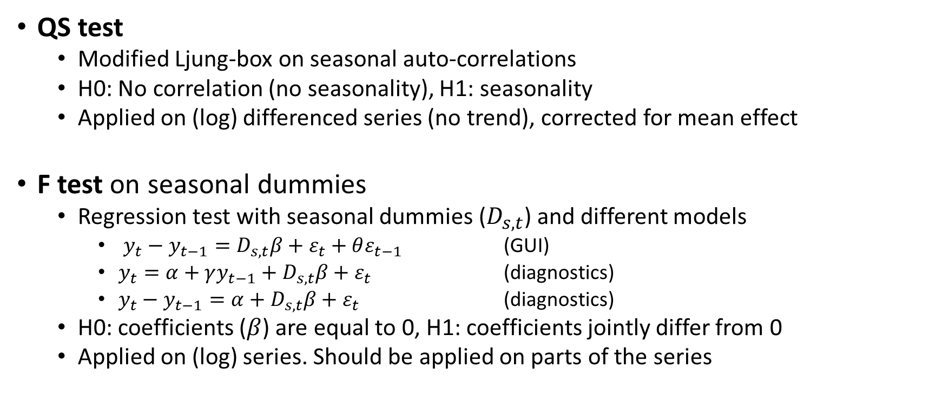
Seasonality tests (cont.)
QS test
Modified Ljung-box on seasonal auto-correlations
H0: No correlation (no seasonality), H1: seasonality
Applied on (log) differenced series (no trend), corrected for mean effect
F test on seasonal dummies
Regression test with seasonal dummies ($D_{s,t}$) and different models
$y_{t}−y_{t−1}=D_{s,t}β+ε_{t}+θε_{t−1}$ (GUI)
$y_{t}=α+γy_{t−1}+D_{s,t}β+ε_{t}$ (diagnostics)
$y_{t}−y_{t−1}=α+D_{s,t}β+ε_{t}$ (diagnostics)
H0: coefficients ($β$) are equal to 0, H1: coefficients jointly differ from 0
Applied on (log) series. Should be applied on parts of the series

Slide 5
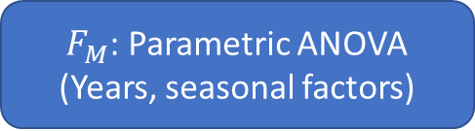
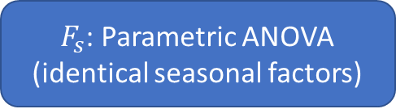

Seasonality tests (cont.)
$F_{s}$: Parametric ANOVA
(identical seasonal factors)
Combined seasonality test (X11-like)
P-value<0.1
$F_{M}$: Parametric ANOVA
(Years, seasonal factors)
$$f(F_{S},F_{M})$$
P-value<0.1
Kruskal-Wallis
(non parametric)
No identifiable seasonality
Probably no identifiable seasonality
Identifiable seasonality

Slide 6
Seasonality tests (cont.)
Spectral diagnostics
Spectral peaks (X13-like)
Based on the spectrum of a long auto-regressive model that fits the series (see X13 documentation)
Periodogram
Performed on the periodogram (Fourier transformation) of the series at the Fourier frequencies.
maximum of the periodogram on or around the seasonal frequencies
sum of the values of the periodogram on or around the seasonal frequencies
Strictly speaking, only valid against the hypothesis that the (transformed) series is a white noise. As the spectral peaks, they don’t perform well for short series.

Slide 7
Seasonality tests (cont.)
Canova-Hansen test (R only)
test the stability of the coefficients of seasonal regressors (model quite similar to the F-test), using a Lagrange multiplier test.
H0: stable seasonal pattern (no seasonality ≡ stable 0 coefficients).
H1: seasonal unit roots.
P-values computed numerically for small samples.

Slide 8
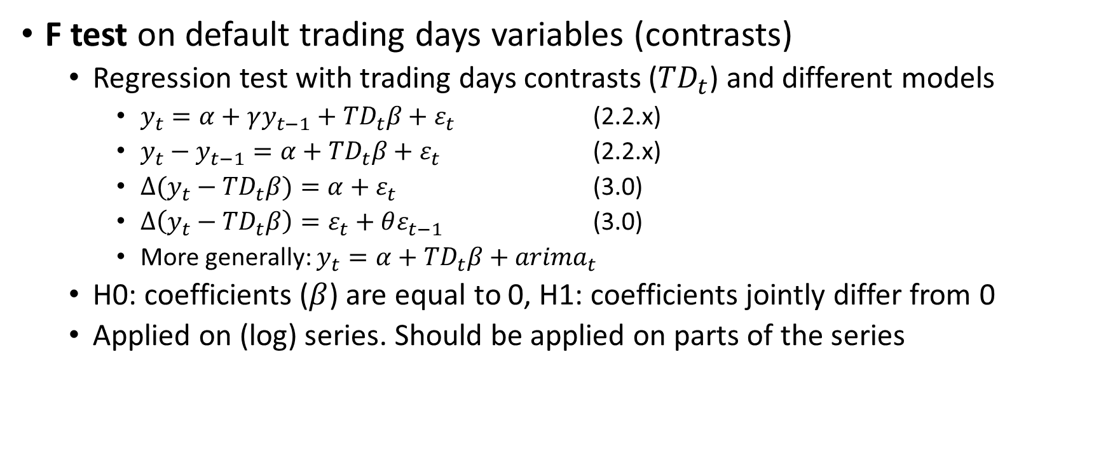
Trading days tests
F test on default trading days variables (contrasts)
Regression test with trading days contrasts (${TD}_{t}$) and different models
$y_{t}=α+γy_{t−1}+{TD}_{t}β+ε_{t}$ (2.2.x)
$y_{t}−y_{t−1}=α+{TD}_{t}β+ε_{t}$ (2.2.x)
$∆(y_{t}−{TD}_{t}β)=α+ε_{t}$ (3.0)
$∆\left(y_{t}−{TD}_{t}β\right)=ε_{t}+θε_{t−1}$ (3.0)
More generally: $y_{t}=α+{TD}_{t}β+{arima}_{t}$
H0: coefficients ($β$) are equal to 0, H1: coefficients jointly differ from 0
Applied on (log) series. Should be applied on parts of the series

Slide 9
Trading days tests(cont.)
Canova-Hansen test on trading days variables (R only)
test the stability of the coefficients of trading days, using a Lagrange multiplier test.
Likelihood test on time varying trading days coefficients (R only)
rjd3toolkit >= 3.2.5

Slide 10
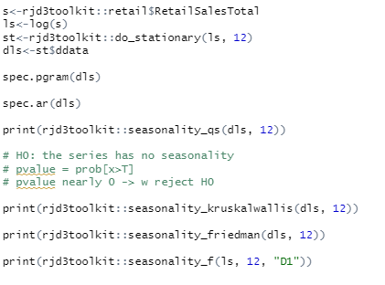
Seasonality tests in R

Slide 11
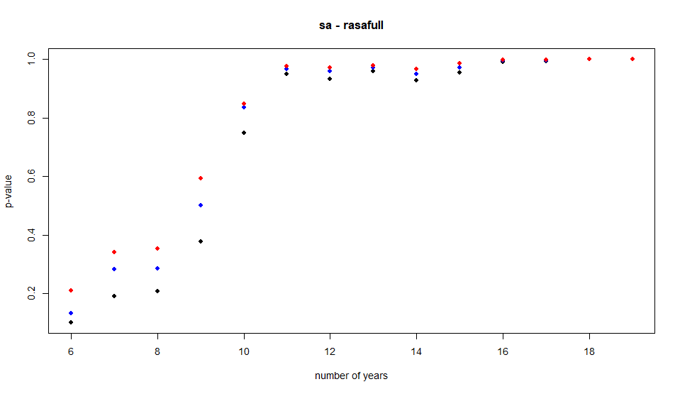
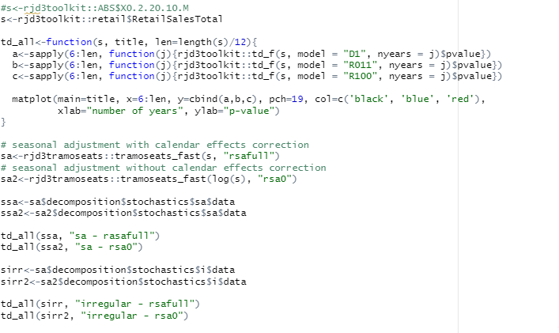
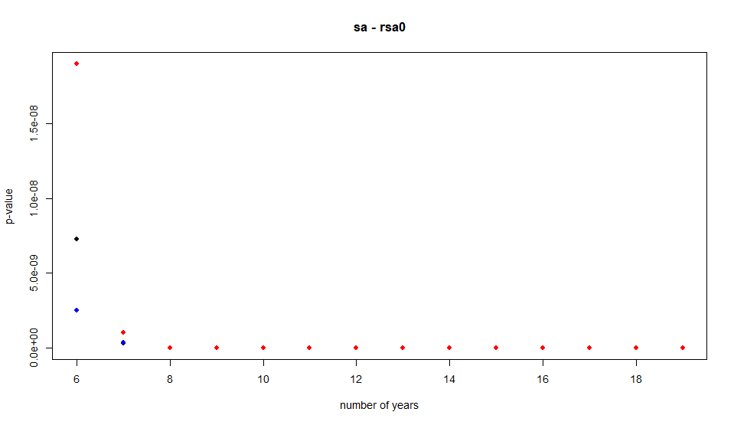
Trading days tests in R

